Slide 1
Activity Diagrams and Getting started with Python Module 2 and 3
Wednesday, 16 February 2022

Slide 2

Coronavirus – current state of affairs
If it is not possible to keep a social distance of 1.5 metres from other people, while sitting down, you need to keep your face mask on during the entire class.
Please attend workcollege that was assigned to you! It is essential to maintain an appropriate number of people per classroom.

Slide 3
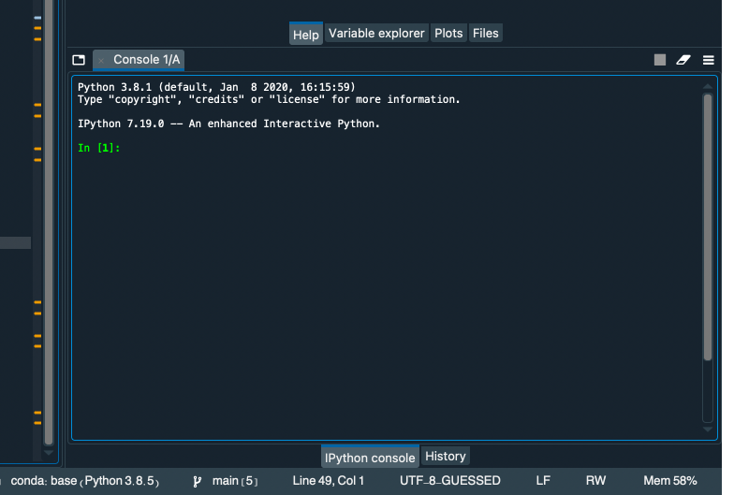
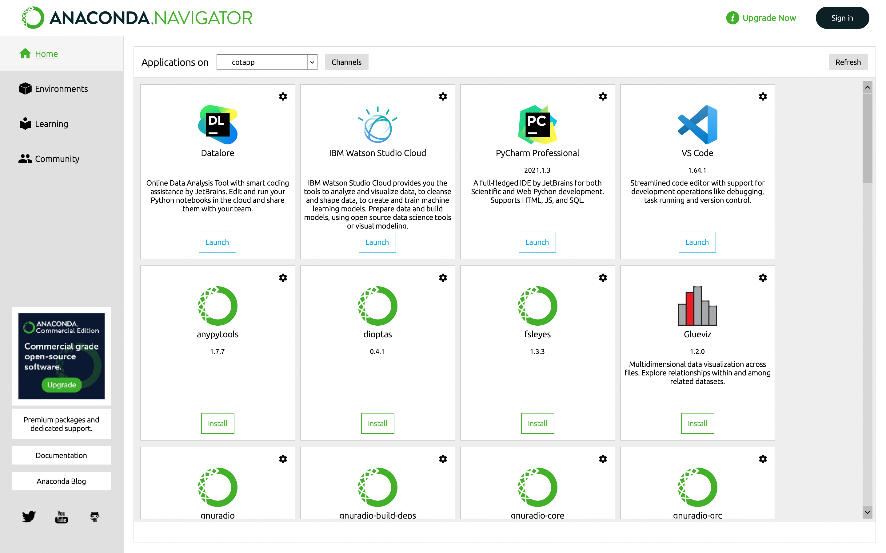
Do you have Python 3.8?
You can check your python version on the Ipython console of Spyder
If you don’t have python 3.8 you should create a virtual environment – ask your TA for help!

Slide 4
Quaterfall exercises (45 minutes)
In Quarterfall you can find the exercises for Module 2:
Understanding Activity Diagrams
Describing Activity Diagrams
Creating Activity Diagrams
Deadline: Friday, 18 of February – 23h30
Module 3:
Understanding python code
Printing source code
List your lectures
Arithmetic Operations
Celsius to Fahrenheit converter
BMI calculation
Deadline: Wednesday, 25 of February – 23h30
Q & A sessions (online):
Monday: 17h15 – 19h00
Tuesday: 9h15 – 11h00
Wednesday: lab
Thursday: 15h15 – 17h00
Friday: 11h15 – 13h00

Slide 5
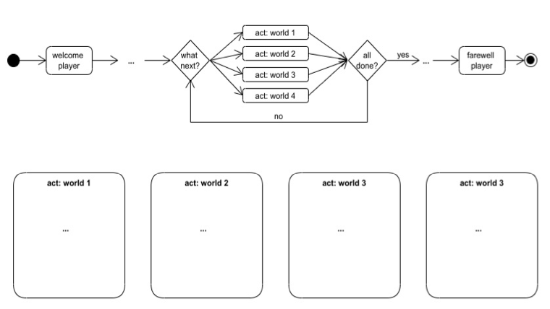
Project 1 – Text Adventure (60 minutes)
In this first group project you will design and implement a text adventure game in Python.
We will only have discussed all programming concepts that are needed next week, but you can right now start with the first part (design of the game concept as Activity Diagrams).
Deadline: Wednesday, 2 of March – 13h00

